Slide 1

Empirical evaluation of using multimodal data to improve performance in Medical Imaging
Anh Tuan LE
Integrated PhD Student
School of Science
Supervisors: Martin MASEK, Jumana ABU-KHALAF, Viet HUYNH

Slide 2
Table of content
Introduction
Background
Research question and hypothesis
Methodology and approach
Research design
Key findings
Significance and impact
Link to future PhD research and discussion
References

Slide 3
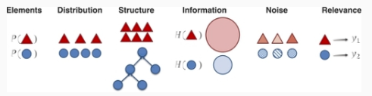
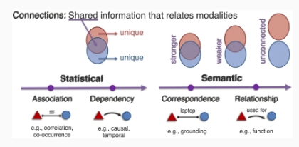
Introduction
Modality
In general: mode that something existed or expressed
In healthcare: method of treatment or diagnosis
In machine learning: data type of dataset
Multimodal in machine learning(ML)
Multi-disciplinary research field
Multimodal ML in healthcare and medical imaging
Heterogeneity and interconnection (Liang P., 2024, page 4)
Fig. 1: Dimensions of heterogeneity (Liang P., 2024, Fig. 2)
Fig. 2: Modality connection (Liang P., 2024, Fig.3)
Notes:
Examples for treatment modality such as surgery or chemotherapy, diagnosis modality such as medical imaging, stimulus diagnosis ,e.g. temperature and sound (Wiki)
Modality in machine learning can be visual, voice, text which can be found in applications of vision/image recognition, speech/dialogue generation, text translation
Multimodal in ML: a type of deep learning that integrates and processes multiple types of data

Slide 4
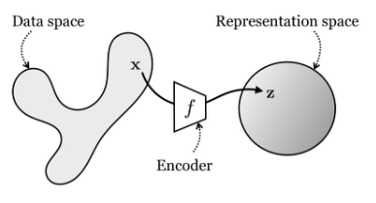
Background
Challenges for multimodal in ML
How to extract useful modality data and eliminate noise
How to fuse values from different modalities
Representation learning
How to define good representation:
Make subsequent tasks easier to solve (Foundation of Computer Vision, Vision Book, MIT)
Smoothness, temporal and spatial coherence, sparsity and natural clusters (Bengio Y., 2013, vol. 35, no. 8, pp. 1798)
Similarity in representation space, easy to obtain even with missing modality, observed modality can fill-in/replace missing modality (Srivastava N., 2012, pp. 2949)
Fig. 3: Representation learning (Foundation of Computer Vision, Vision Book, MIT, Fig. 30.1)
Notes:
Challenges in multimodal ML: challenging to construct good multimodal representation due to their heterogeneity, mapping from one modality to another, e.g. Xray image and text report, alignment between sub-elements from different modalities, fusion and transfer learning (Baltrušaitis, T., 2018, section 1)
Representation learning is very common in computer vision to process vision/image in which high dimension image can be processed to lower dimension/latent space and extracted features in latent space will be used in down stream tasks
Representation learning has 2 learning principles: Compression, e.g. autoencoding, clustering, and Prediction, e.g. future prediction, imputation prediction for missing data (30 Representation Learning – Foundations of Computer Vision. (n.d.). https://visionbook.mit.edu/representation_learning.html)

Slide 5
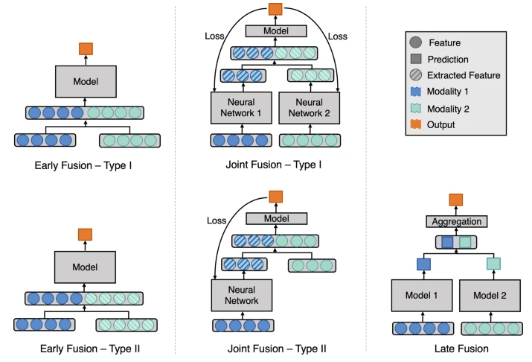
Background
Fusion methods:
Early: fuse the data inputs
Intermediate/Joint: join the extracted features to train the model
Late: aggregate the outputs
Fig. 4: Fusion strategies in Deep learning (Huang, SC, 2020, Fig. 2)

Slide 6
Research statement and hypothesis
Research statement:
The integration of multimodal data can improve the performance of machine learning in healthcare
Hypothesis:
Using multimodal medical imaging data with deep representation learning can improve accuracy for classification tasks compared to single modality

Slide 7
Methodology and approach
Methodology:
Quasi-experiments: only studies with frontal-view images are selected to build dataset for unsupervised learning and filtered studies for each disease label are used to train downstream classifiers
Using machine learning workflow
Ethical considerations
Use public dataset
Data management followed provider constraint and ECU compliance
Data pre-processing
Model training
Model evaluation
MIMIC
CXR dataset
Image
Text
Label
Training set
Filter
Split
Validation set
(Frontal view only)
Test set
Data pre-processing
Notes:
Approach: Empirical review to select dataset, architect/design, models…

Slide 8
Workflow details
Image
Unimodal model
Train
Objective function
Train
Objective function
Text
Multimodal model
Training phase 1: unsupervised learning for representation
Image representation
Unimodal classifier model
Train
Obj func
Image
Unimodal model
Image representation
Multimodal classifier model
Train
Obj func
Multimodal model
Training phase 2: supervised learning for disease classifier
Label

Slide 9
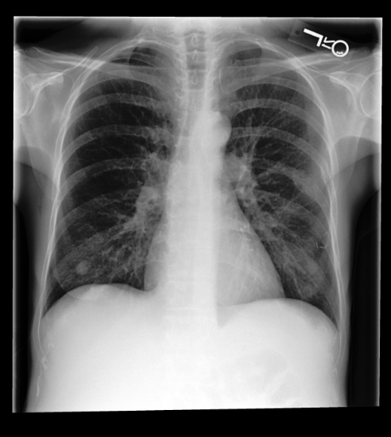
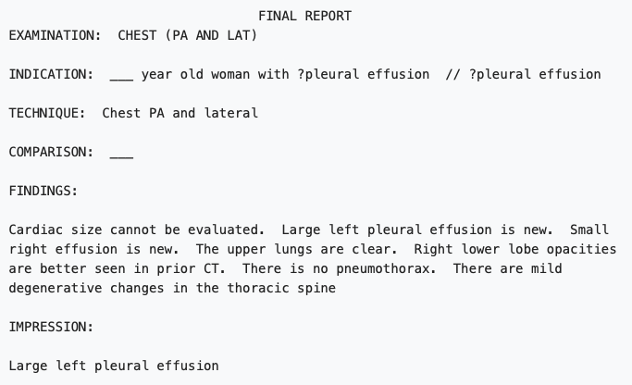
Research design
Dataset selection criterion:
Heterogeneity and interconnection between modalities
Enough samples to train models sufficiently
MIMIC-CXR v2.0:
Total of 377K chest images
250K radiographic studies with frontal-view and their associated radiology reports
The label for image was generated by ChesXpert tool(with 96% accuracy) from parsing ‘IMPRESSION’ section in free-text report
Fig. 5: frontal chest xray and free-text report

Slide 10
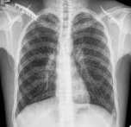
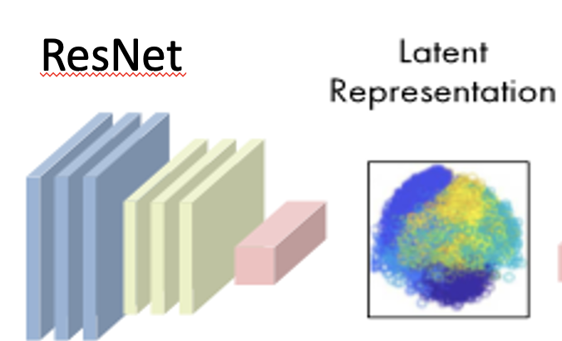
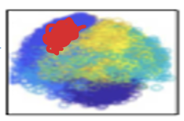

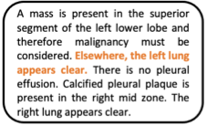
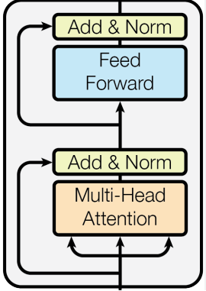
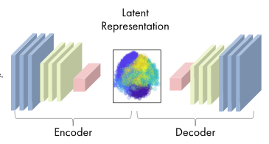
Research design
Mutual Information
Bert transformer
Fuse
Fig. 6: Multimodal with Mutual Information
ResNet
Fig. 7: Unimodal with AutoEncoder
Notes:
Training phase 1: Representation unsupervised learning
Objective function for Multimodal: maximize Mutual Information between image embeddings and text embeddings
Objective function for AutoEncoder: minimize error in reconstruct image from Decoder

Slide 11
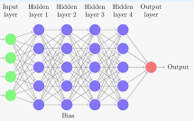



Research design
Disease classifier- Multilayer Perceptron
Fig. 8: downstream classifier with Multimodal
ResNet
Fig. 9: Unimodal with AutoEncoder
Notes:
Training phase 2: supervised learning with label data

Slide 12
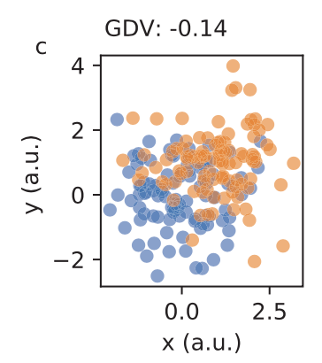
Research design
Metric:
Accuracy
Separability:

Slide 13
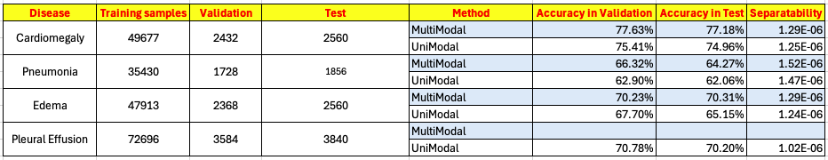
Findings
Multimodal compared to Unimodal
Accuracy:
Validation: increase from 2.22% to 3.42%
Test dataset for unseen data: increase from 2.22% to 5.16%
Separability:
Increase from 3% to 4%

Slide 14
Significance and impact
Significance
Provide fair comparison between Multimodal and Unimodal
Experiment in big dataset
Implement metric for representation training
Impact
Create foundation works for PhD research about how to interpret/explain the multimodal data
Provide code to public with dataset population, end-to-end training for representation learning (Mutual Information for image/text Encoders and Unimodal with AutoEncoder), supervised learning for image classifiers and metric generation for validation

Slide 15
PhD research topic and discussion
Research topics:
Multimodal explanations, e.g….
XAI methods with multimodal data to improve prediction results

Slide 16
Appendix for Implementation details
Multimodal settings: training_epochs= 20
Image encoder: model= ResNet256_6_2_1
Text encoder: model= Bert transformer, settings=default pre-trained model
Mutual Information: calculation formula = DV algorithm
Code repository: https://github.com/RayRuizhiLiao/mutual_info_img_txt
UnimodaL settings: training_epochs=20
Encoder: model= ResNet256_6_2_1
Decoder: model= ResNet256Decoder with ConvTranspose2D for DeConv layers
AutoEncoder: objective function = error cost
Code repository: https://github.com/arnaghosh/Auto-Encoder
Classifier settings: training_epochs= 20
Multilayer Perceptron: 7 layers
Mini project:
Code repository: https://github.com/vnoz/Mutual-Information-MultiModal

Slide 17
References
30 Representation Learning – Foundations of Computer Vision(n.d.) https://visionbook.mit.edu/representation_learning.html
Baltrušaitis, T., Ahuja, C., & Morency, L. P. (2018). Multimodal machine learning: A survey and taxonomy. IEEE transactions on pattern analysis and machine intelligence, 41(2), 423-443.
Huang, SC., Pareek, A., Seyyedi, S. et al. Fusion of medical imaging and electronic health records using deep learning: a systematic review and implementation guidelines. npj Digit. Med. 3, 136 (2020). https://doi.org/10.1038/s41746-020-00341-z
Johnson, A.E.W., Pollard, T.J., Berkowitz, S.J. et al. MIMIC-CXR, a de-identified publicly available database of chest radiographs with free-text reports. Sci Data 6, 317 (2019). https://doi.org/10.1038/s41597-019-0322-0
Liang, P. P., Zadeh, A., & Morency, L. P. (2024). Foundations & trends in multimodal machine learning: Principles, challenges, and open questions. ACM Computing Surveys, 56(10), 1-42.
Schilling, A., Maier, A., Gerum, R., Metzner, C., & Krauss, P. (2021). Quantifying the separability of data classes in neural networks. Neural Networks, 139, 278-293.

Slide 18
Q&A

